Slide 1


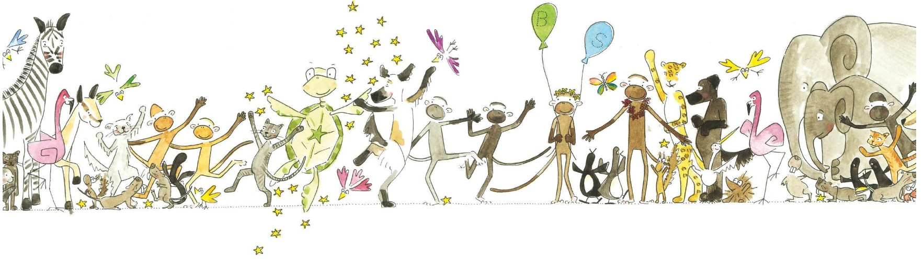
Merley First School

Slide 2
The why

Slide 3
Why Kinetic Letters?
Kinetic Letters aims is to make handwriting automatic (without thinking) therefore allowing children’s writing focus to be on the content rather than handwriting as they progress through school.
It is a systematic, rapidly progressive sensory programme built upon child development principles.
Margarate Williamson, the founder of KL comes from a child development, occupational therapy and teaching background.

Slide 4
It deserves quality curriculum time, since in order to master this complex interaction of cognitive and motor skills, pupils need careful, systematic teaching of the skills involved, and the time to practise them.
In addition to promoting automaticity, psychological research confirms that handwriting actually develops connectivity patterns in the brain, producing optimal conditions for learning.
And the physical dexterity acquired through handwriting helps pupils with handling tools and typing.’

Slide 5
Our aim

Slide 6

Overview of Programme
The programme has 4 main threads -
•Red – making bodies stronger (this is ongoing)
•Green – holding a pencil correctly
•Yellow – letter formation
•Blue – writing with fluency (speed)
The 4 threads come together to enable children to develop legible handwriting that is produced quickly and automatically.
Developing automaticity is central to the Kinetic Letters programme.
Making handwriting a valuable tool and impacting every curriculum area.
Notes:
The scheme builds towards automaticity
Enabling the children to form letters correctly without having to think how to form them.
Freeing up space in their conscious working brain.

Slide 7
Progressive programme
Beginning in Reception and finishing in Year 6.
Handwriting families
Interventions
Daily structured lesson
Lessons last approx 20 mins.
Lessons follow a structure
Structures in routines within the lessons
Multisensory
Rhymes and songs
Different body positions to ensure correct posture
Puppets! Monkey and Turtle!
Stories!
Fully Resourced
Physical and digital resources.
Handbook for each class
Activities for children with additional needs
A full suite of resources to support teaching eg: whiteboards with lines

Slide 8
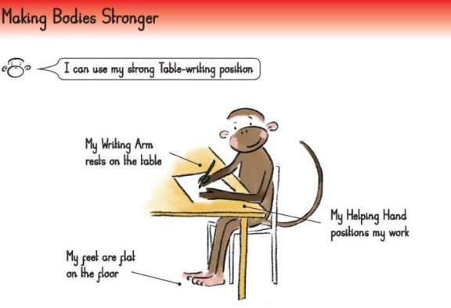
Handwriting requires more than just hand and muscles.
Strong core muscles
Strong shoulder muscles
Strong wrists
Notes:
You need to be strong to write
Pelvic girdle strength
Shoulder Girdle strength
Forearm and wrist
Hand and finger
All contribute to dexterity and manipulation

Slide 9
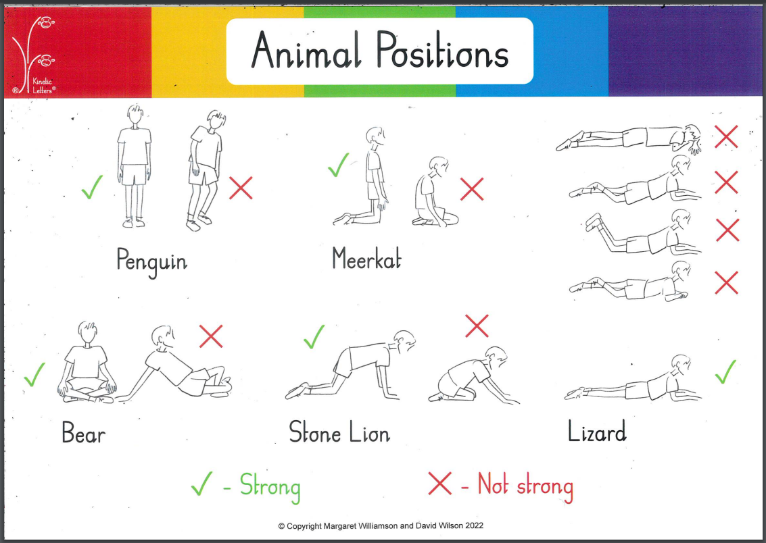
Notes:
Incorporate throughout the school day eg lining up in penguin, sitting in bear, kneeing in meerkat

Slide 10
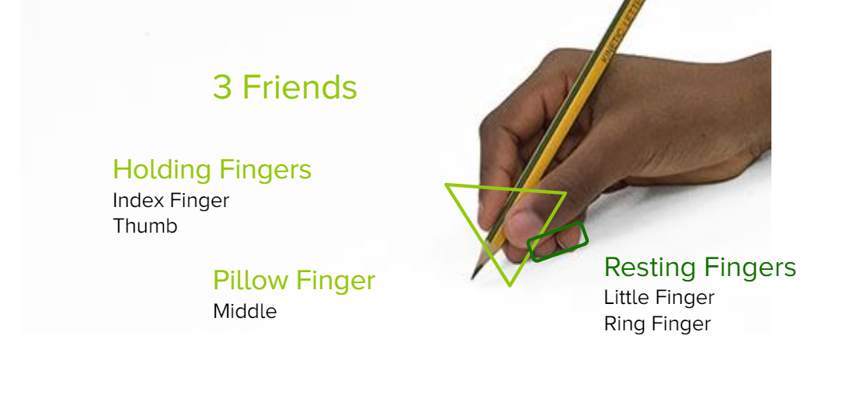
Holding the pencil
Pencil workout!
Notes:
85% of school day pupils hold their pencils on average

Slide 11
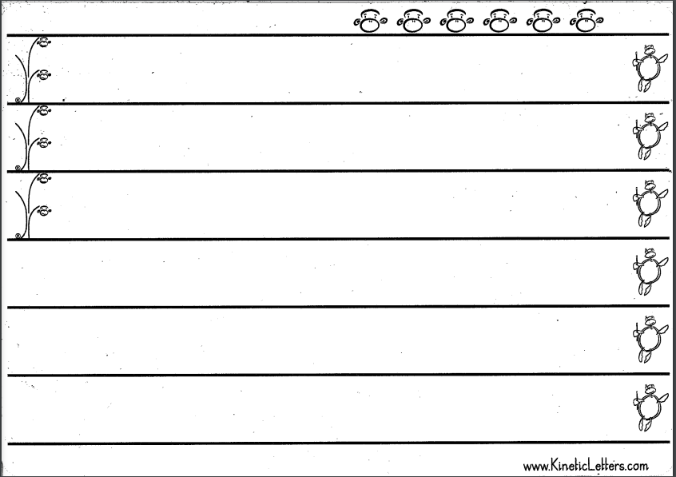
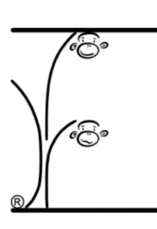
Example of tree and line guides
Notes:
The monkeys and the tree help to form the letters giving precise start and finish points
It helps pupils to assess detect and correct their errors
Teach moves - up down slide flick
Teachers always model letters using the tree making sure to use the tree and a ground line
In summary:
The tree symbol is the prompt for formation, orientation, grounding and heights of letters.

Slide 12

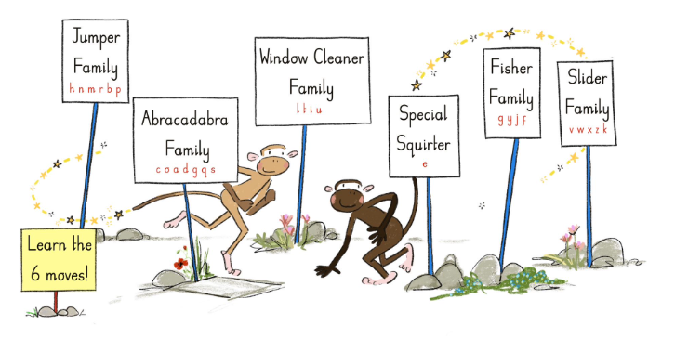
Letter Families
Lower case letter formation is taught within letter families.
Six letter families - each family has a story - each letter family share features which help with accurate and rapid learning.
Stories help memory and recall.
Each family has a feature which
creates rapid learning.

Slide 13
Impact
So far we had seen huge improvements in the children's letter formation, grounding and general writing stamina.
The children know the structure of the lessons, the letters rhymes, positions and families.
They are also engaged - it has been commented on by outside professionals how engaged the children are in KL lessons.

Slide 14
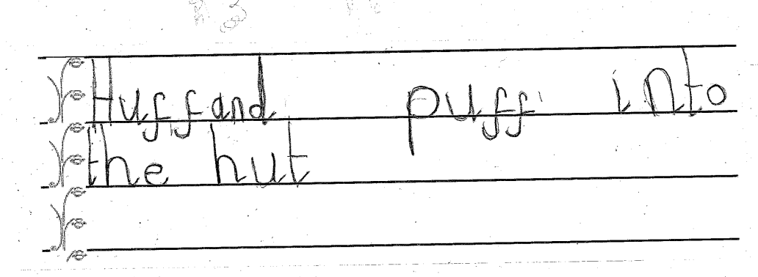
Reception Writing

Slide 15
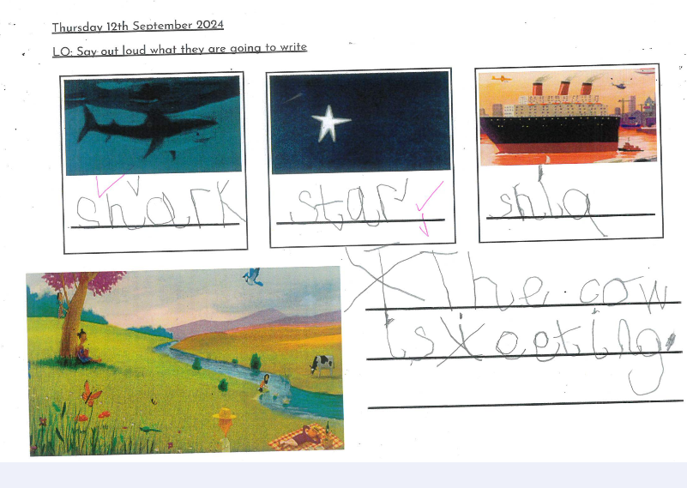
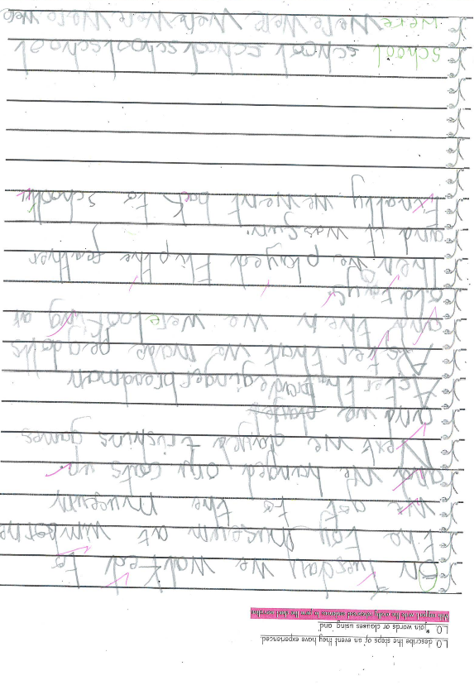
Year 1 Writing

Slide 16
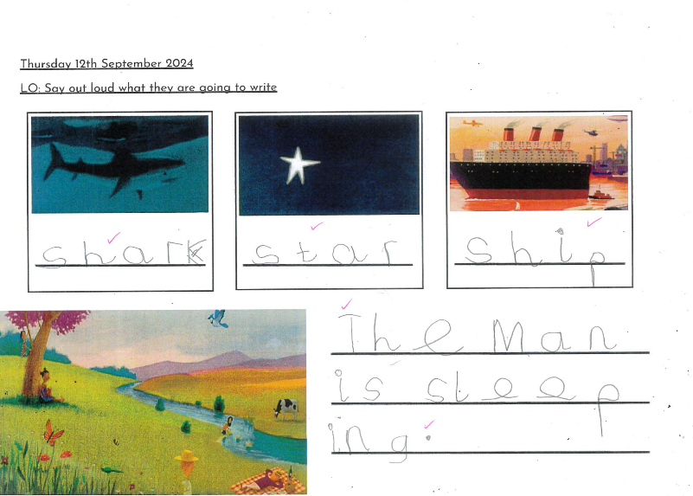
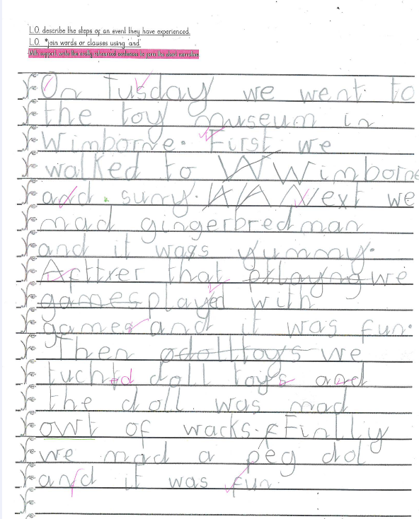
Year 1 Writing

Slide 17
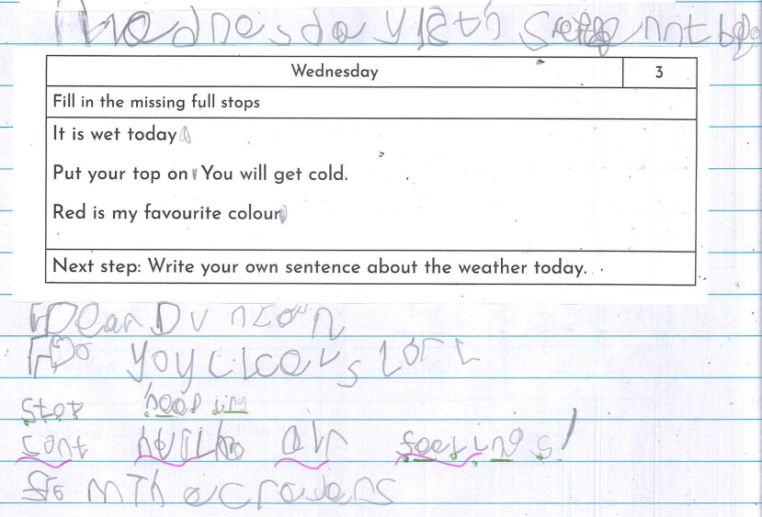
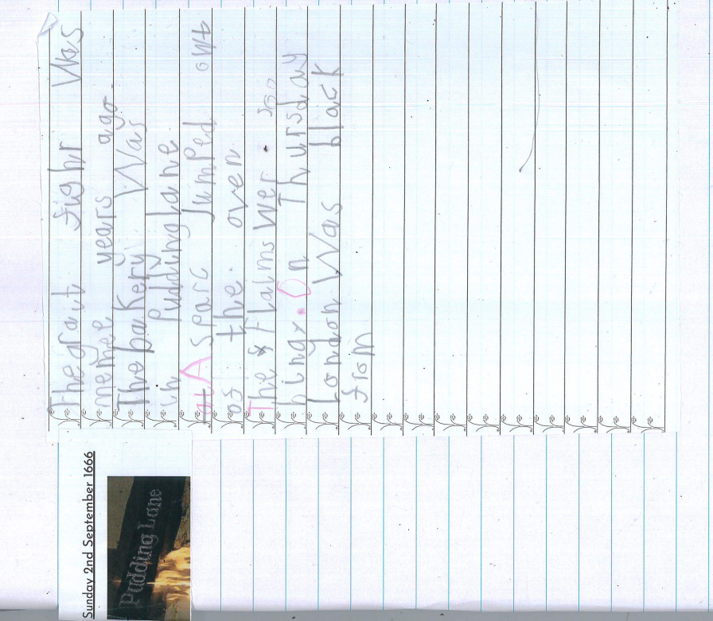

Slide 18


