Slide 1
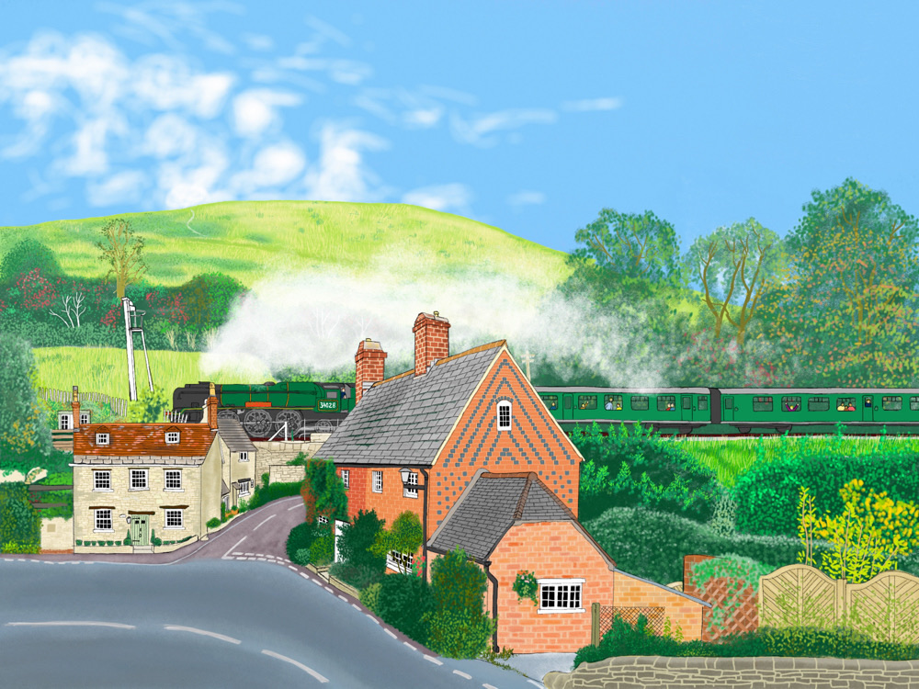
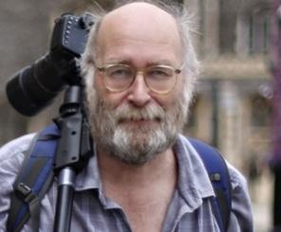
The David Hendrey Art Prize

Slide 2
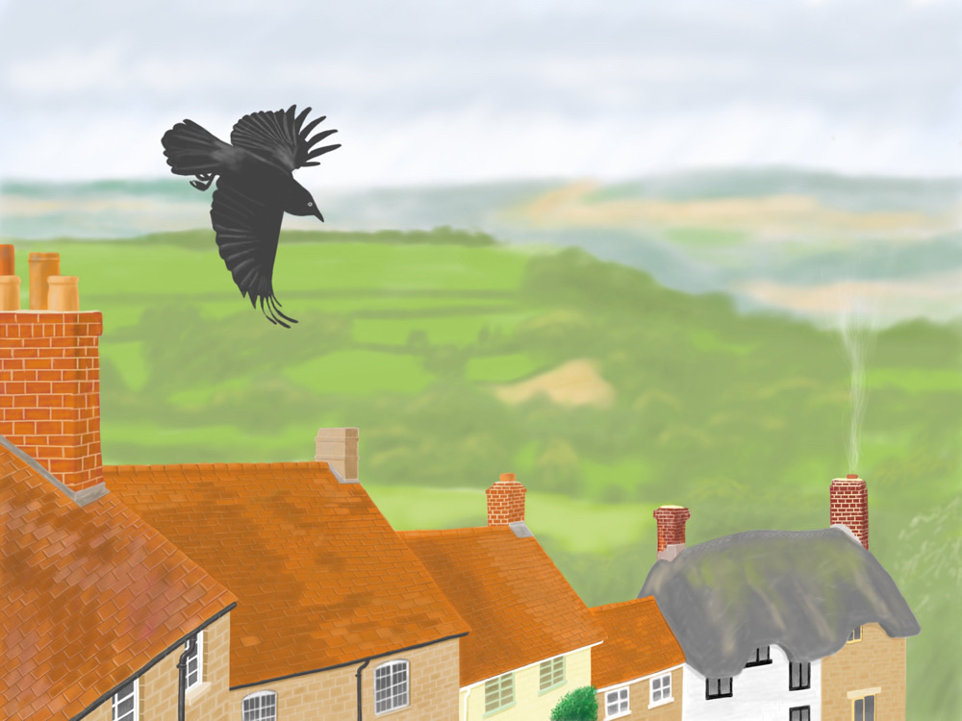
David Hendrey
Teacher and Artist

Slide 3
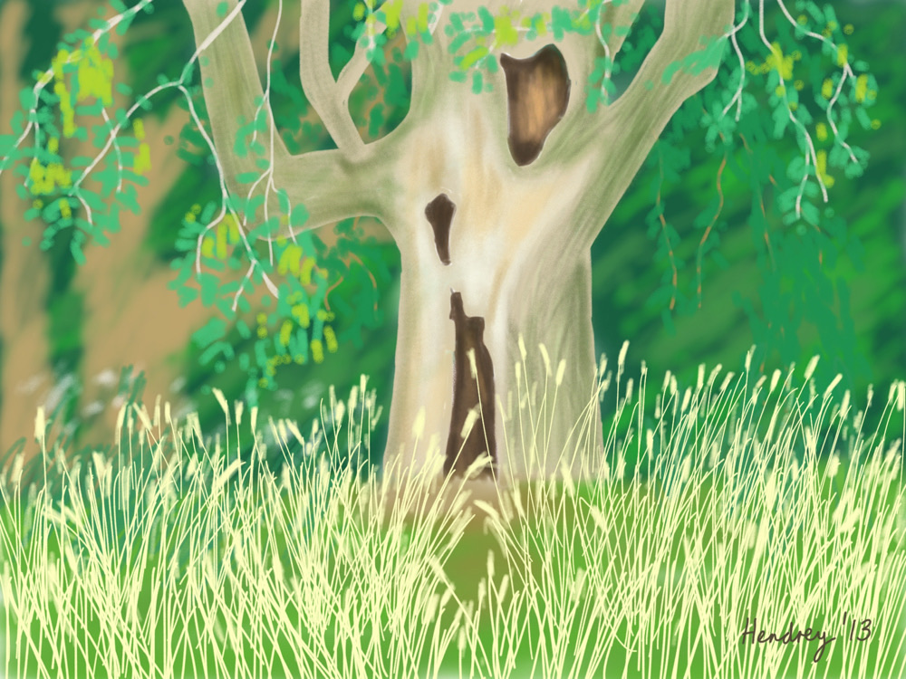
David taught at Merley First School for 30 years.

Slide 4
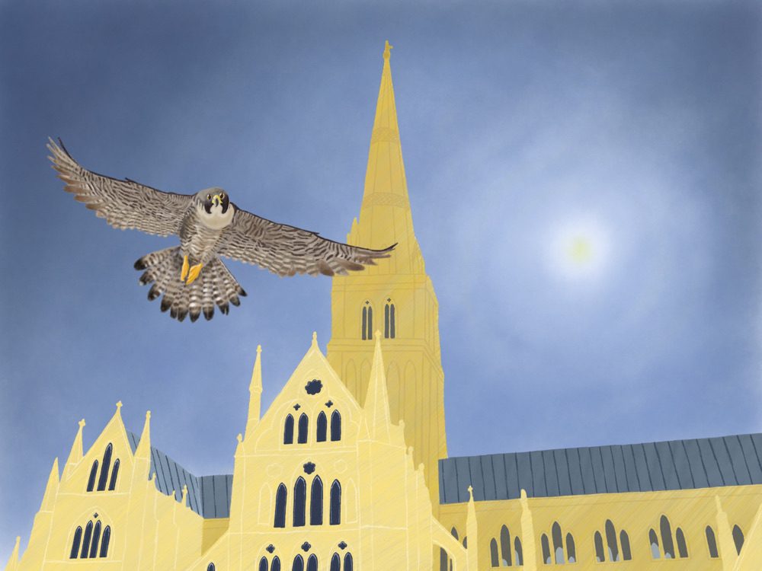
Before he became a teacher he was an illustrator for a magazine.

Slide 5
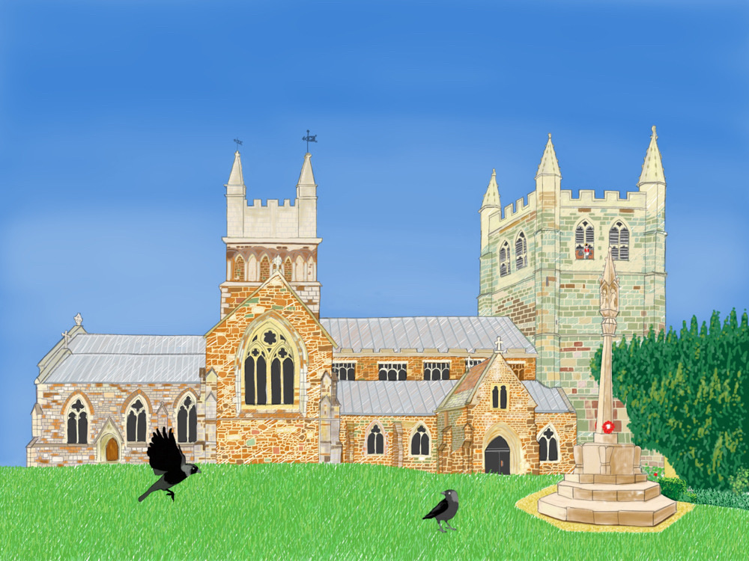
When he retired from teaching he revived his interest in art, using an iPad to create some wonderful pictures.

Slide 6
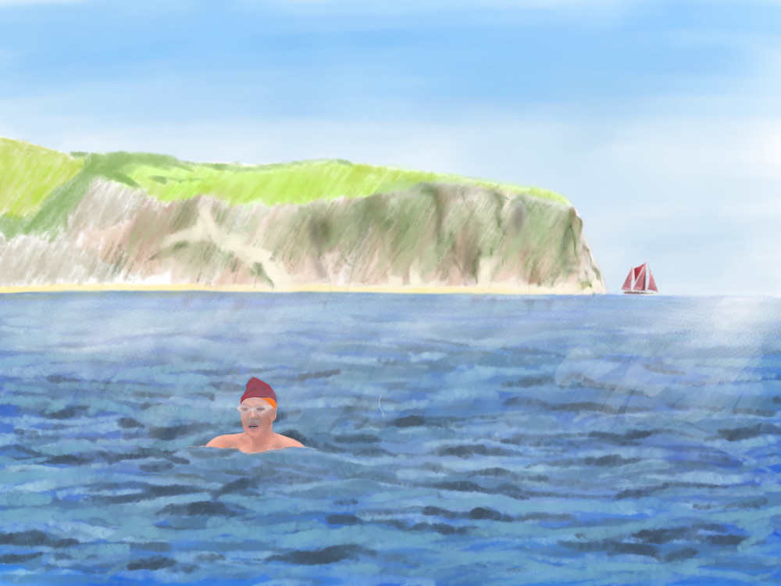
David sadly died from Covid 19 in January 2021

Slide 7
The David Hendrey Art Prize
His family and friends have set up a fund to provide an annual prize for art for pupils of Merley First School.
Pupils can enter by submitting any type of art work by
30th June 2021
Please submit your work to the school office.
Photographs of work are allowed.

